Slide 1
Robotic Fabrication - Introduction

Slide 2
Agenda
Robot Introduction
UR Introduction
Robot Control
UR Online Control
Installation
GH Interface Introduction

Slide 3
Robot introduction

Slide 4
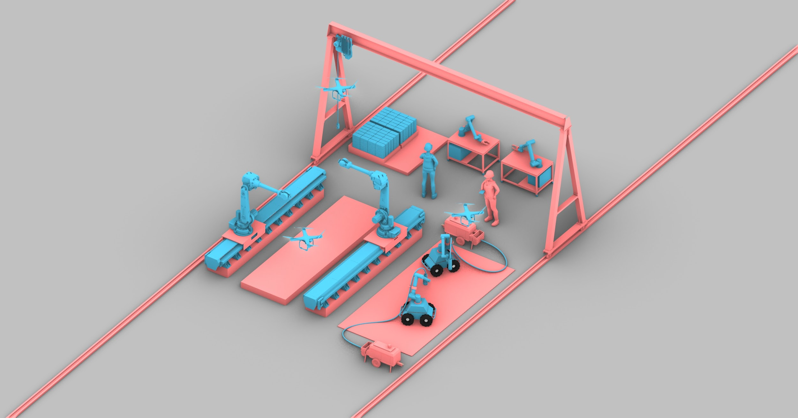

Notes:
G: What is a robot?
The robot is a machine that, independently of its exterior, is able to modify the environment in which it operates.
_Robotics_ is commonly defined as the science studying the _intelligent connection between perception and action_.
https://www.federica.eu/l/introduction_to_robotics
B. Siciliano, L. Sciavicco, L. Villani, G. Oriolo, Robotics: Modelling, Planning and Control, Springer, London, 2009, ISBN 978-1-84628-642-1

Slide 5
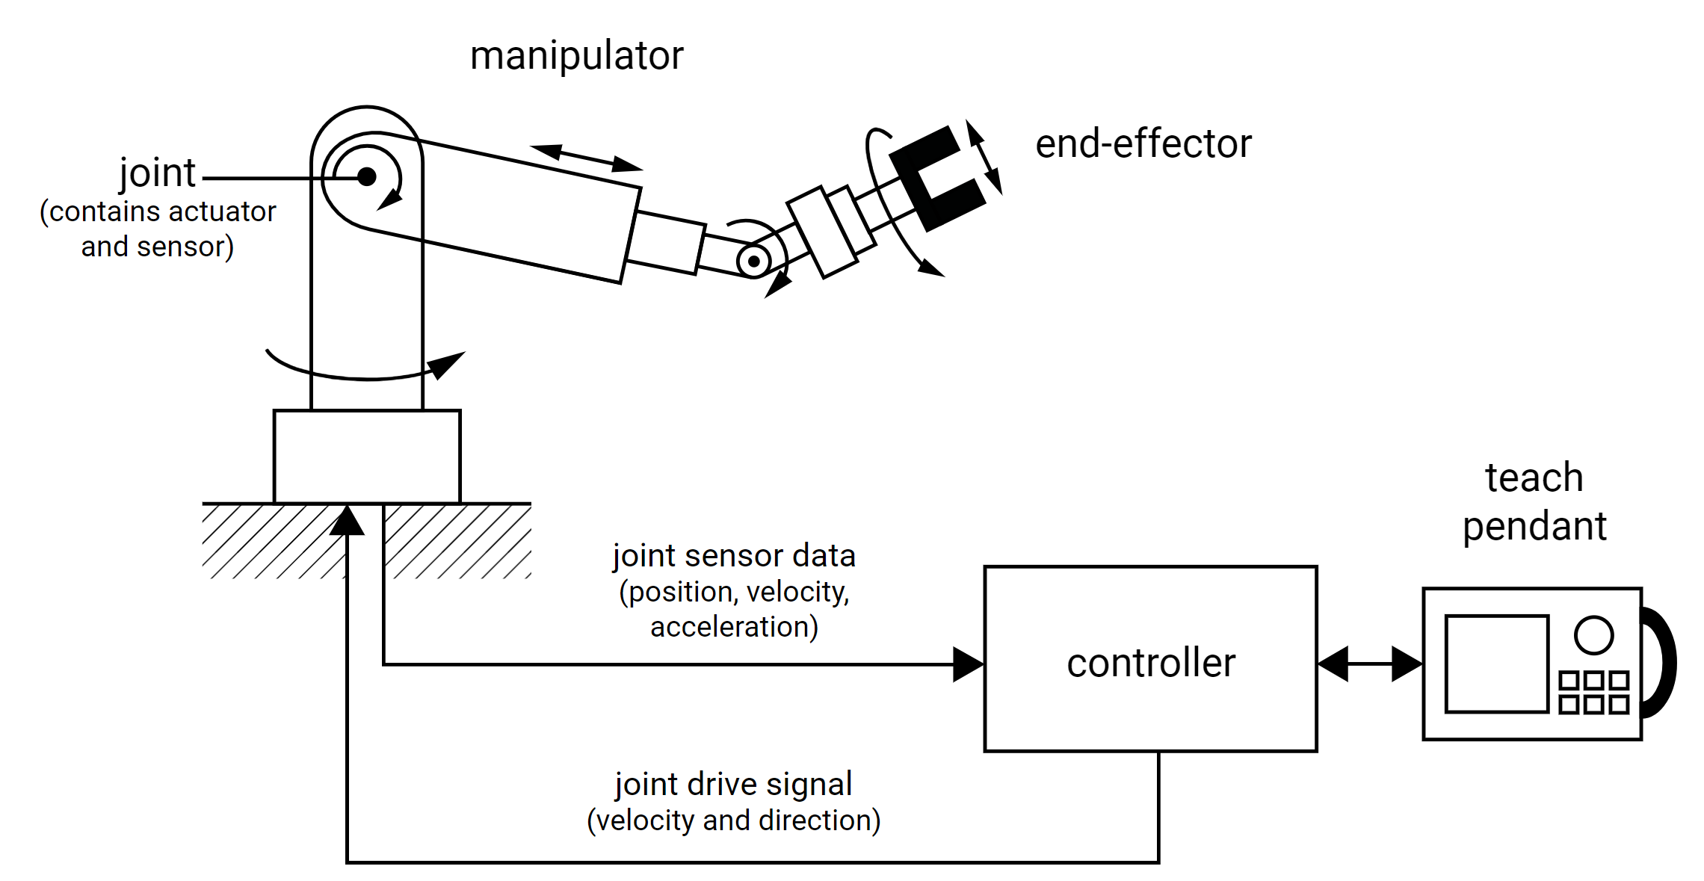
Basic components of a robot
Manipulator
End-effector
Actuators
Internal sensors
External sensors
Controller
Teach pendant
external
sensor
Notes:
Manipulator
A collection of links (mechanical linkages) connected by joints
Generally, joints are either revolute (rotary) or prismatic (linear)
Each joint has joint axis along which the particular link either rotates or slides
Every joint axis identifies a degree of freedom (DOF)
End-effector
The part that is connected to the last joint of a manipulator
The hand or tool which performs the required task depending on the fabrication process
If actuated (e.g. gripper gripping) the end-effector can be controlled by the robots controller via I/O.
Actuators
Used to move the elements of the manipulators
Each actuator is driven by a controller
Can be electric motors (servomotor, stepper motor), pneumatic cylinders or hydraulic cylinders
Sensors
Internal sensors: check joint position, temperature, force, ...
External sensors: percept environment
Controller
Brain of the robot
Receives the data from the computer, controls the motions of the actuators and coordintes the motions with the sensory feedback information.
Teach pendant
A control box for programming the motions of a robot
Teach pendants are typically handheld devices and may be wired or wireless

Slide 6
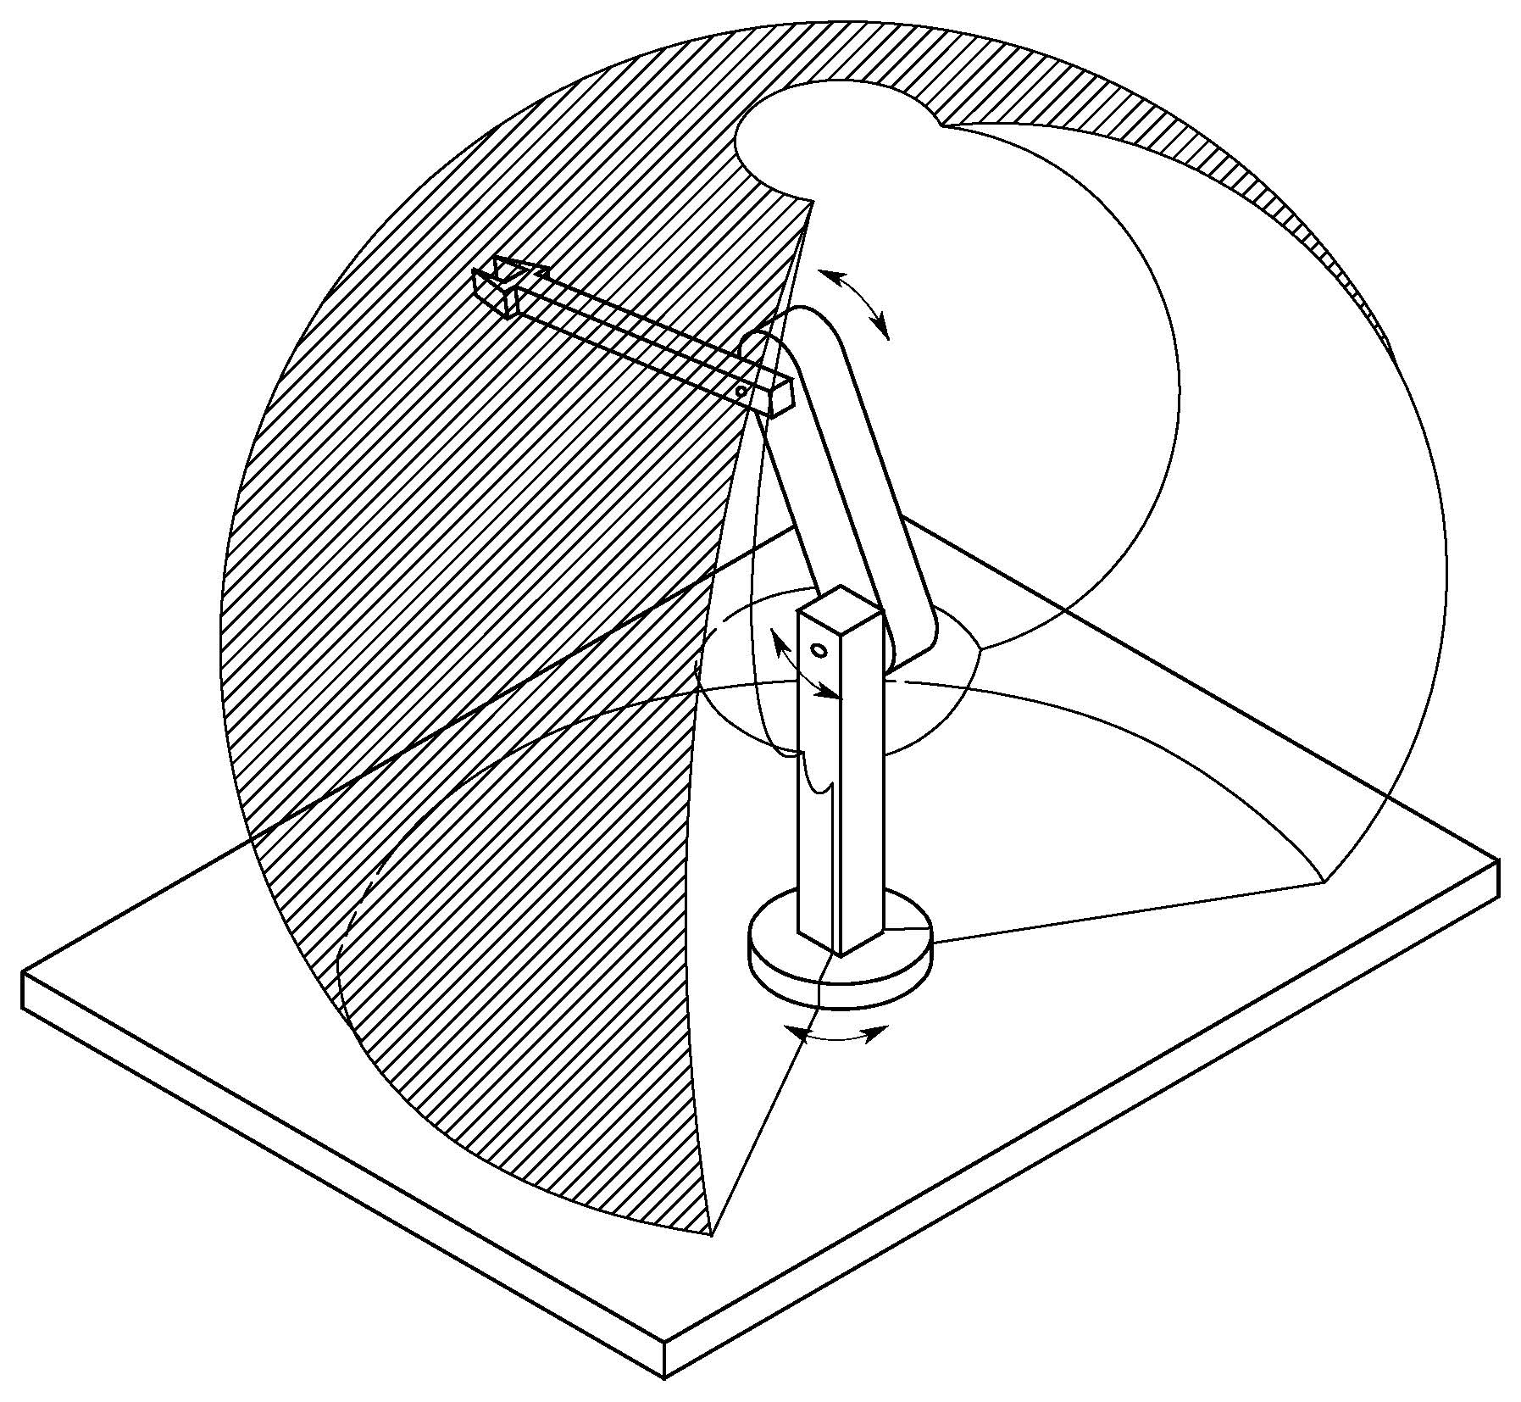
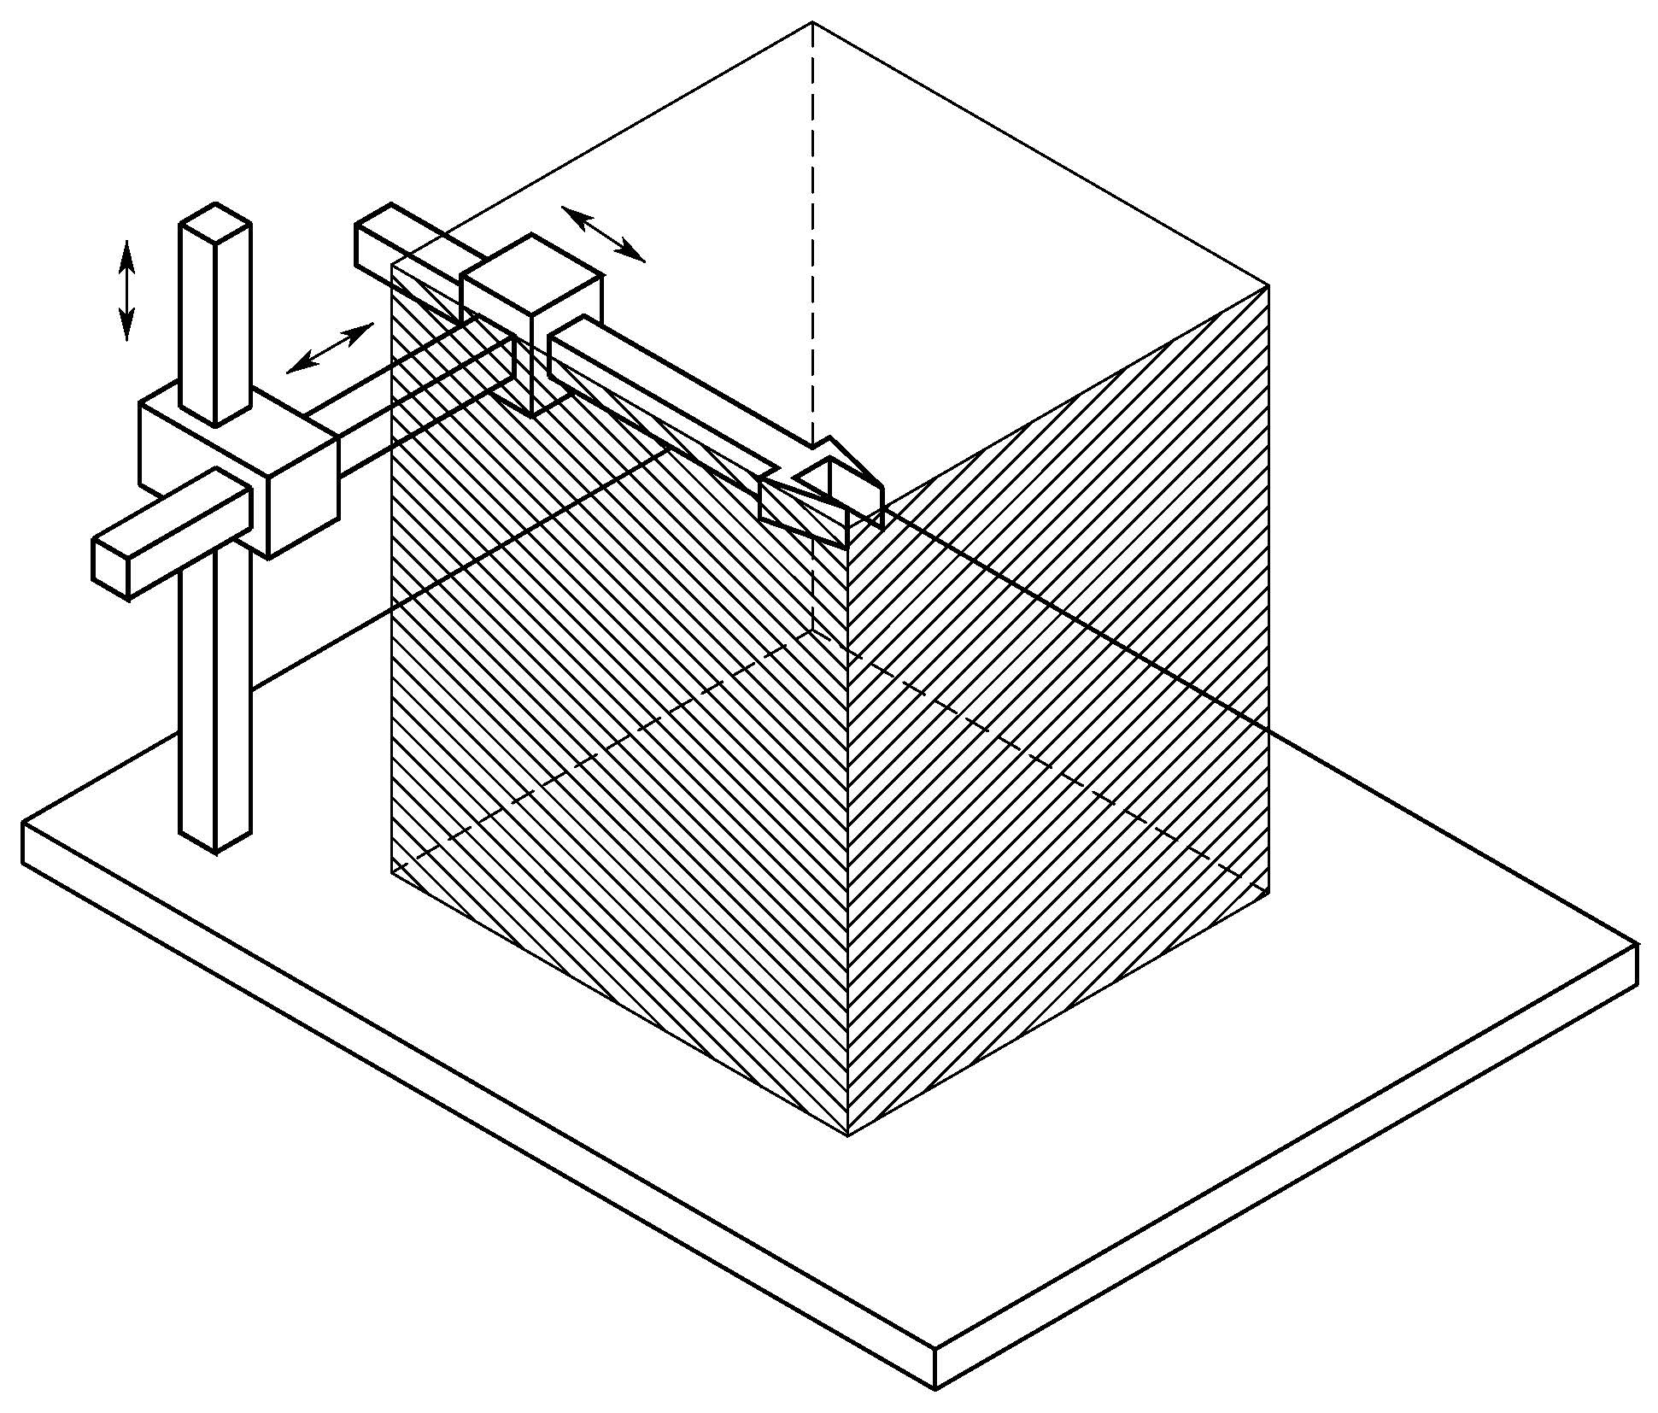
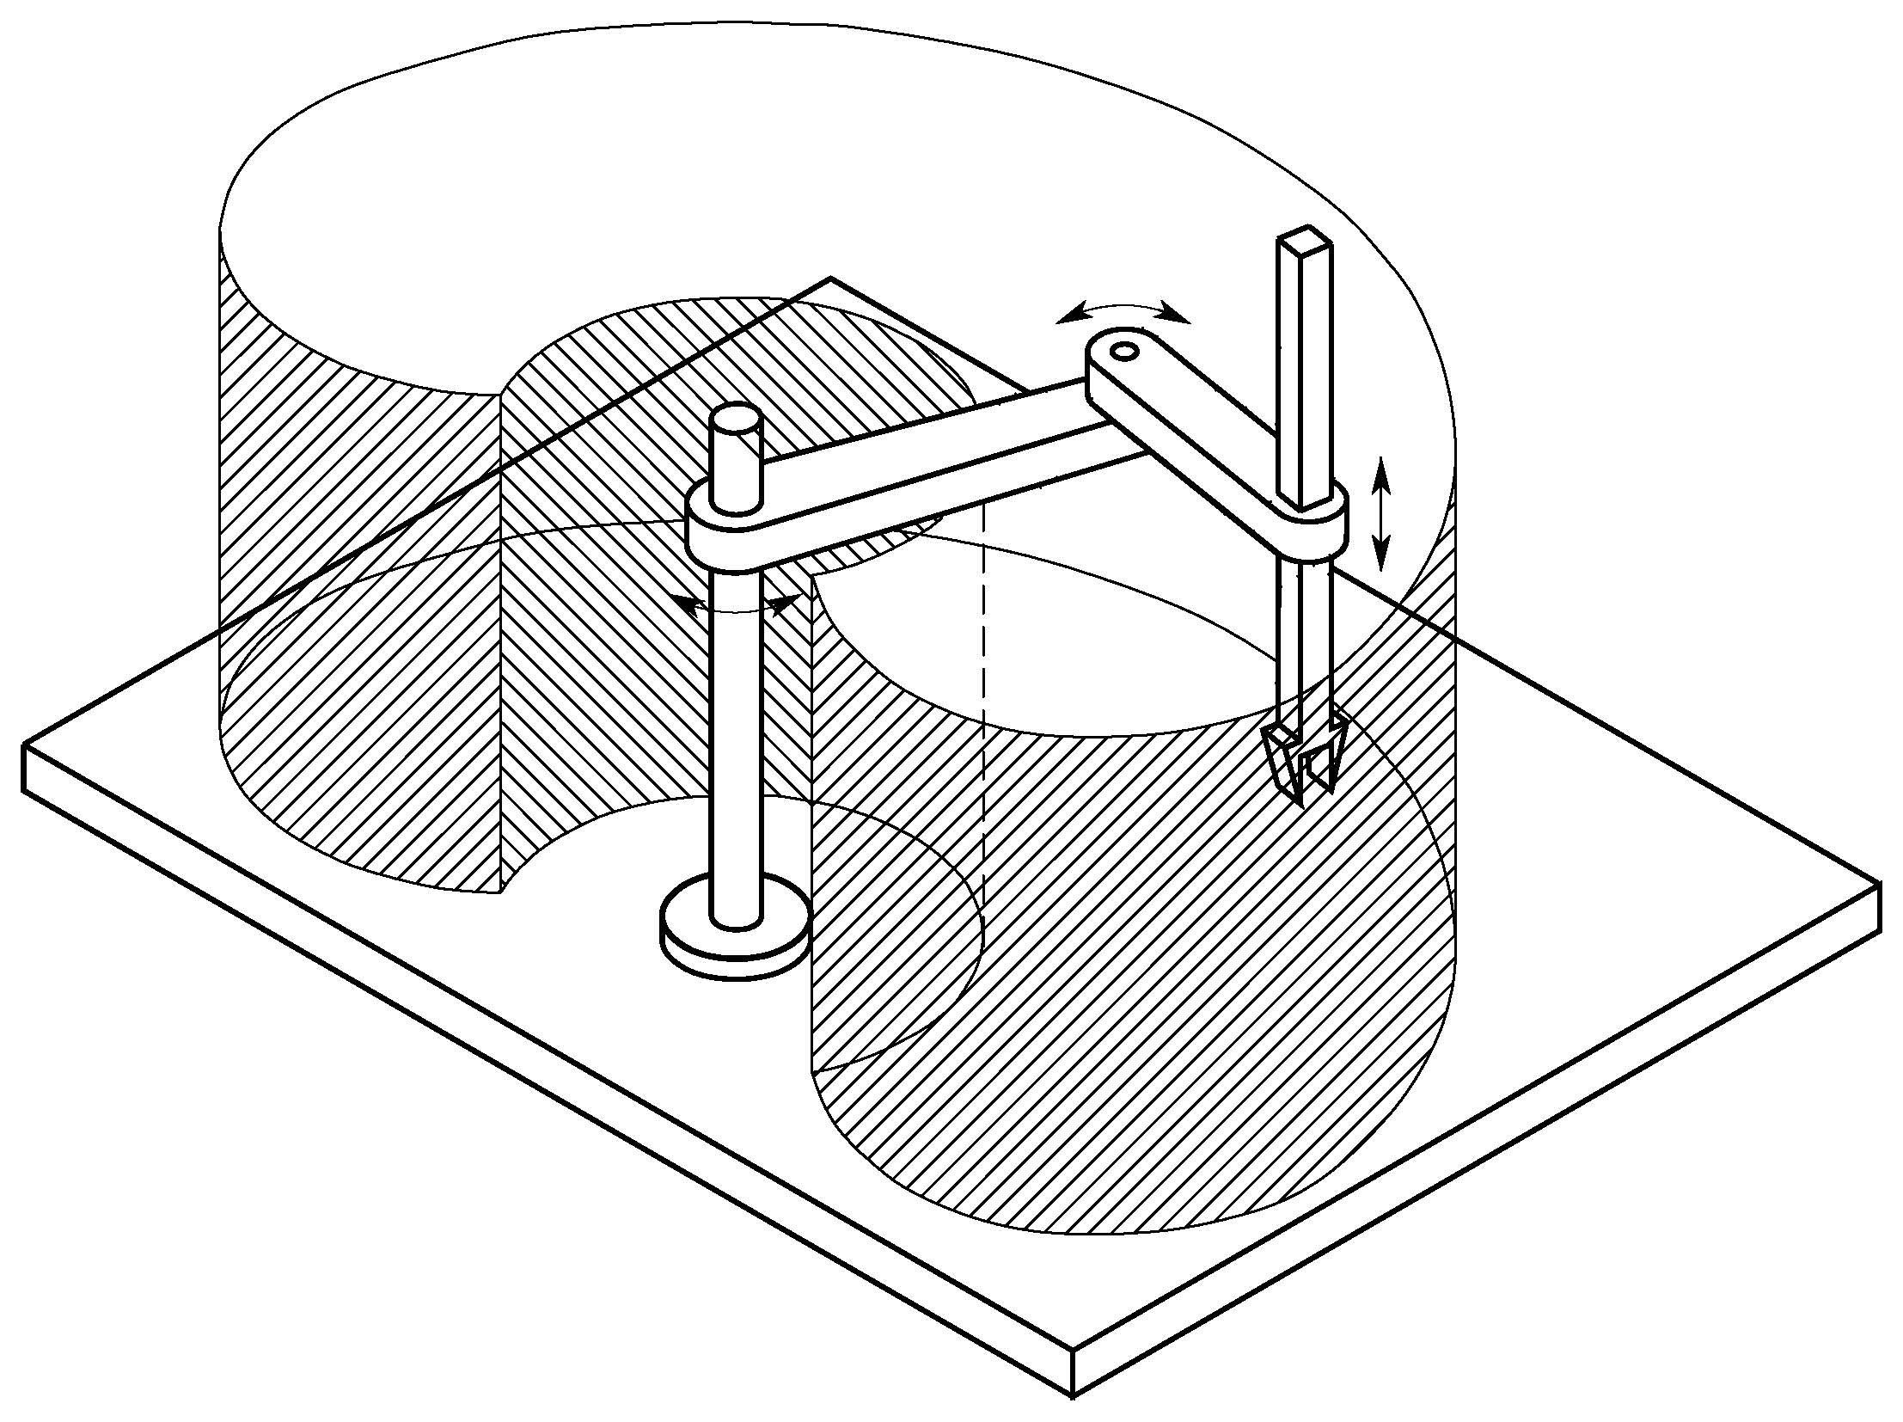
Robot workspace
Anthropomorphic manipulator
SCARA manipulator
Cartesian manipulator
Notes:
Depending on the robot’s design, the workspace is the envelope the robot can reach.

Slide 7
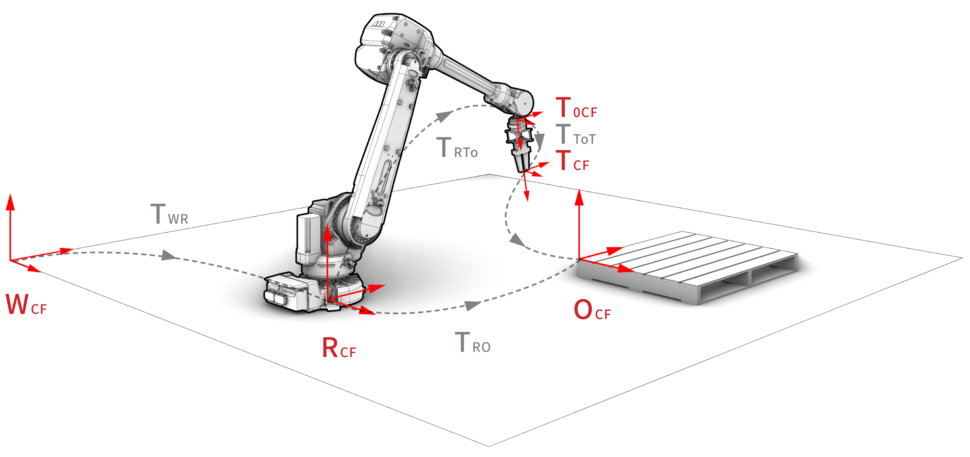
Robot coordinate frames
World (WCF)
Robot (RCF)
Tool0 (T0CF)
Tool (TCF)
Object (OCF)
Notes:
To coordinate the robot motions in a cartesian coordinate space (as opposed to other spaces such as the joint space), we have to define a set of coordinate frames.

Slide 8
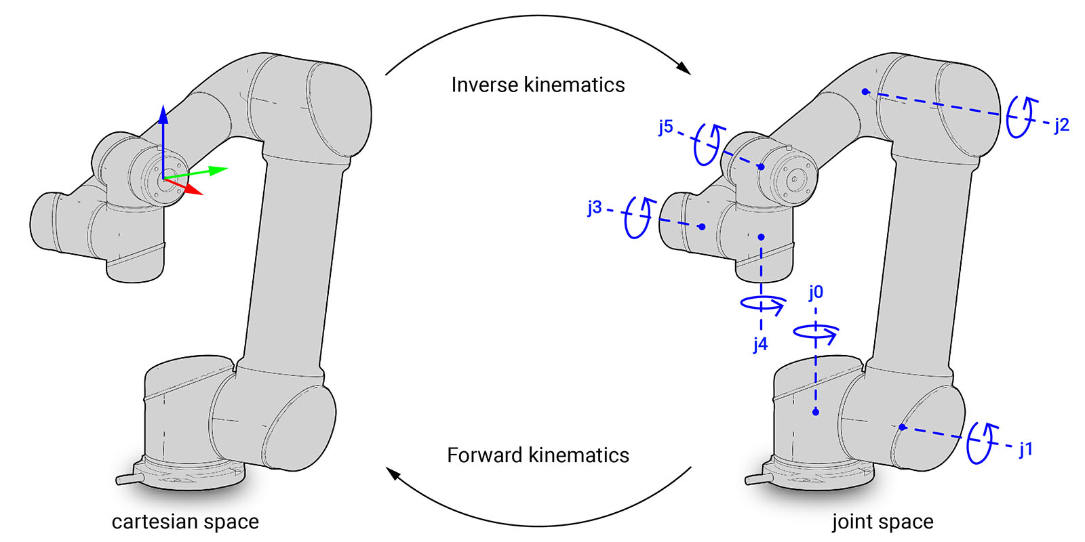
Cartesian vs joint space
Notes:
Then, the typical industrial robot can be controlled in two spaces: joint space and cartesian space.
MoveJ – move the robot linear in joint space
MoveL or MoveC – move the robot linear/circular in cartesian space (ee-velocity)
For MoveL you specify a desired pose for the end-effector AND a desired Cartesian path. To find the necessary joint positions along the desired Cartesian path, the robot controller must calculate the inverse position and velocity kinematics of the robot.

Slide 9
UR robot introduction

Slide 10
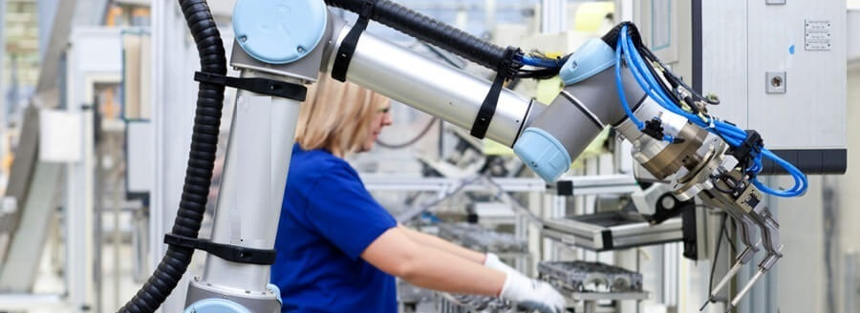
UR robot introduction
Notes:
… belongs to the family of cobots, = collaborative robots
The big difference of cobots with robots is that they don’t should not operate in closed-off areas. Instead, they can and should safely operate alongside and even collaborate with human workers, and are easy to program.

Slide 11
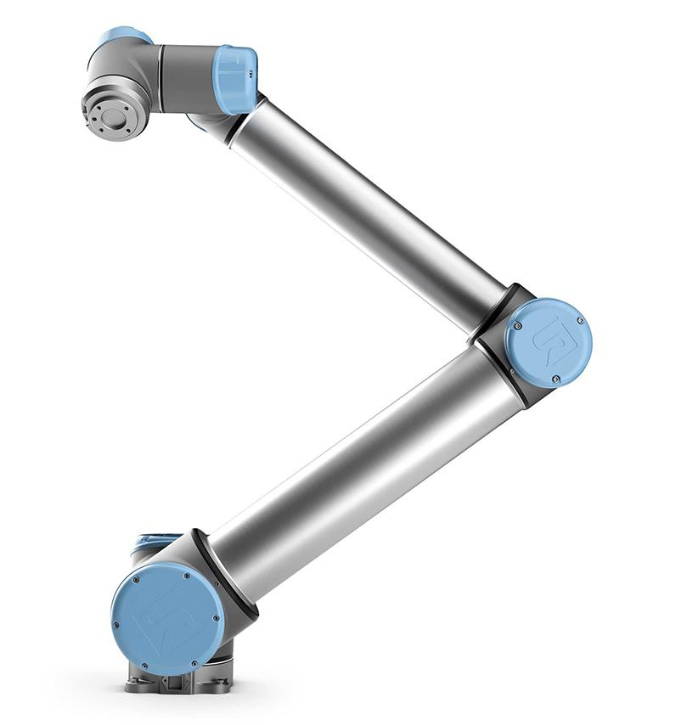
UR robot introduction
UR 10e
Notes:
We will work this semester with the
UR10e
Payload 10kg

Slide 12
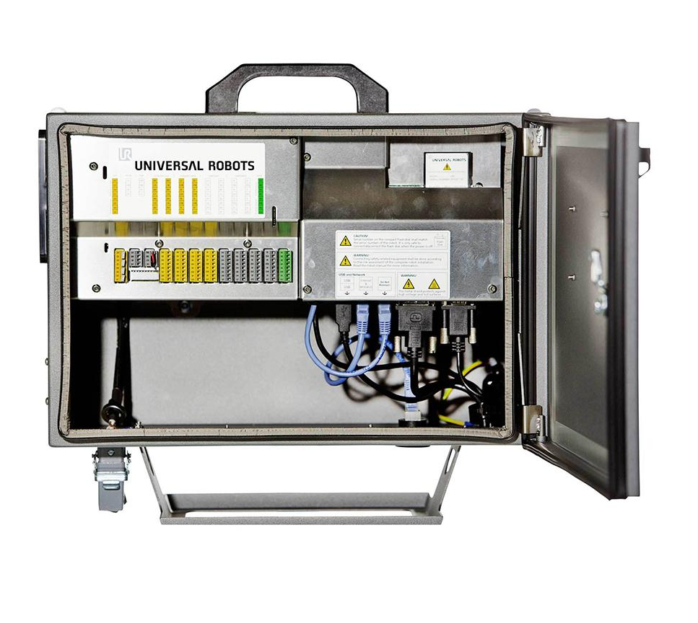
UR robot introduction
Controller
UR 10e
Notes:
comes with a controller

Slide 13
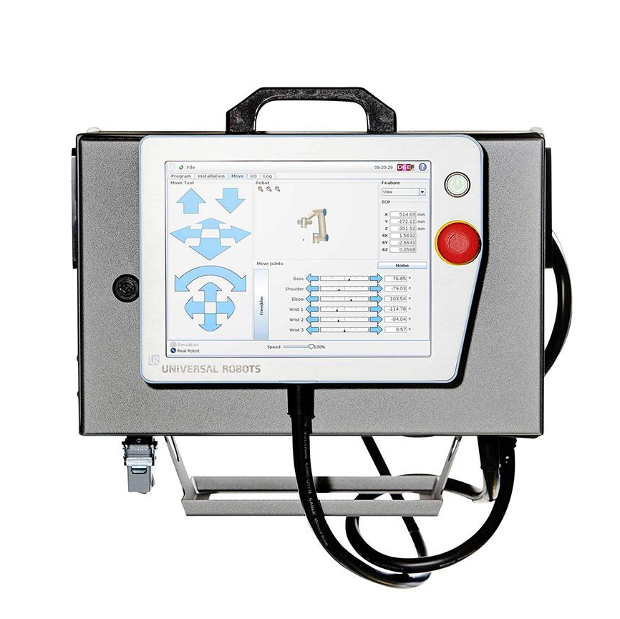
UR robot introduction
Controller
Teach Pendant
UR 10e
Notes:
and a teach pendant

Slide 14
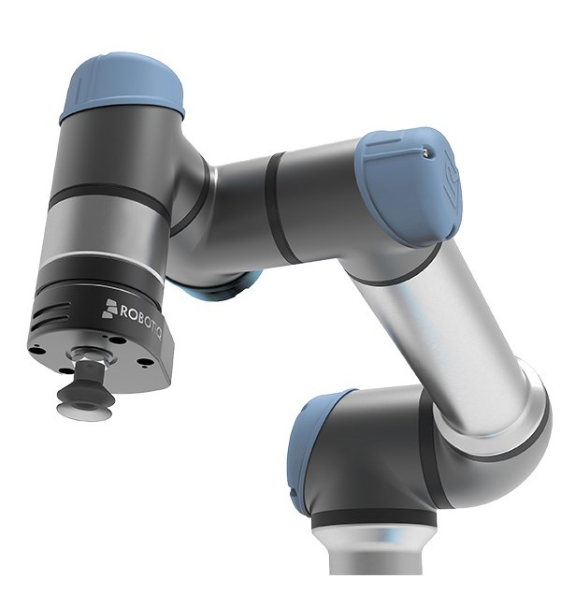
UR robot introduction
Notes:
and can be customised with various end effectors...

Slide 15
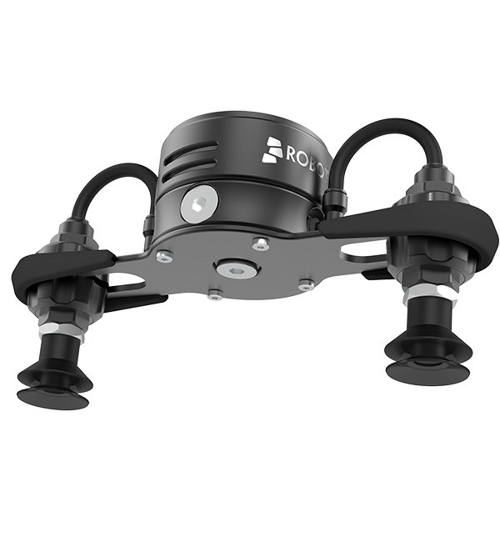
UR robot introduction
Notes:
such as the robotiq vacuum gripper air pick

Slide 16
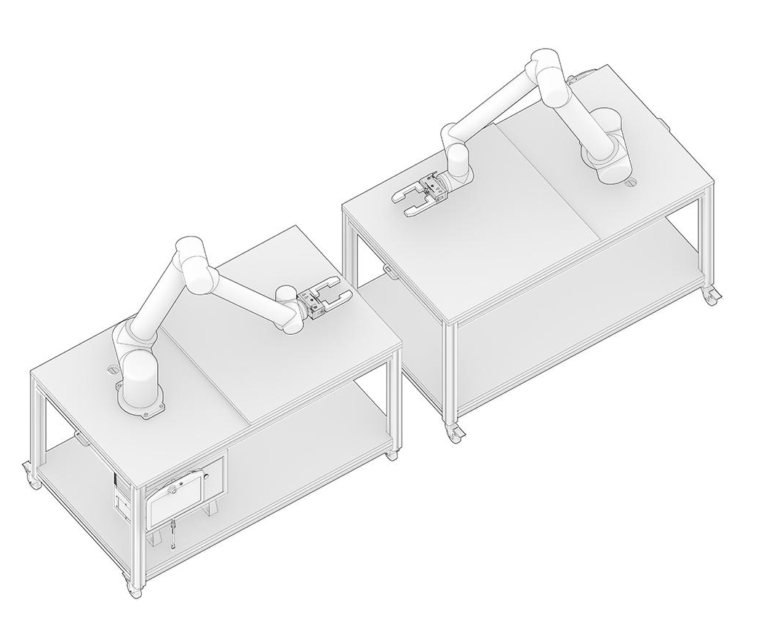
Robotic setup: 2 x UR10e

Slide 17
Robot Control

Slide 18
Robot Control
Offline control
Online control
real-time
non-real-time

Slide 19
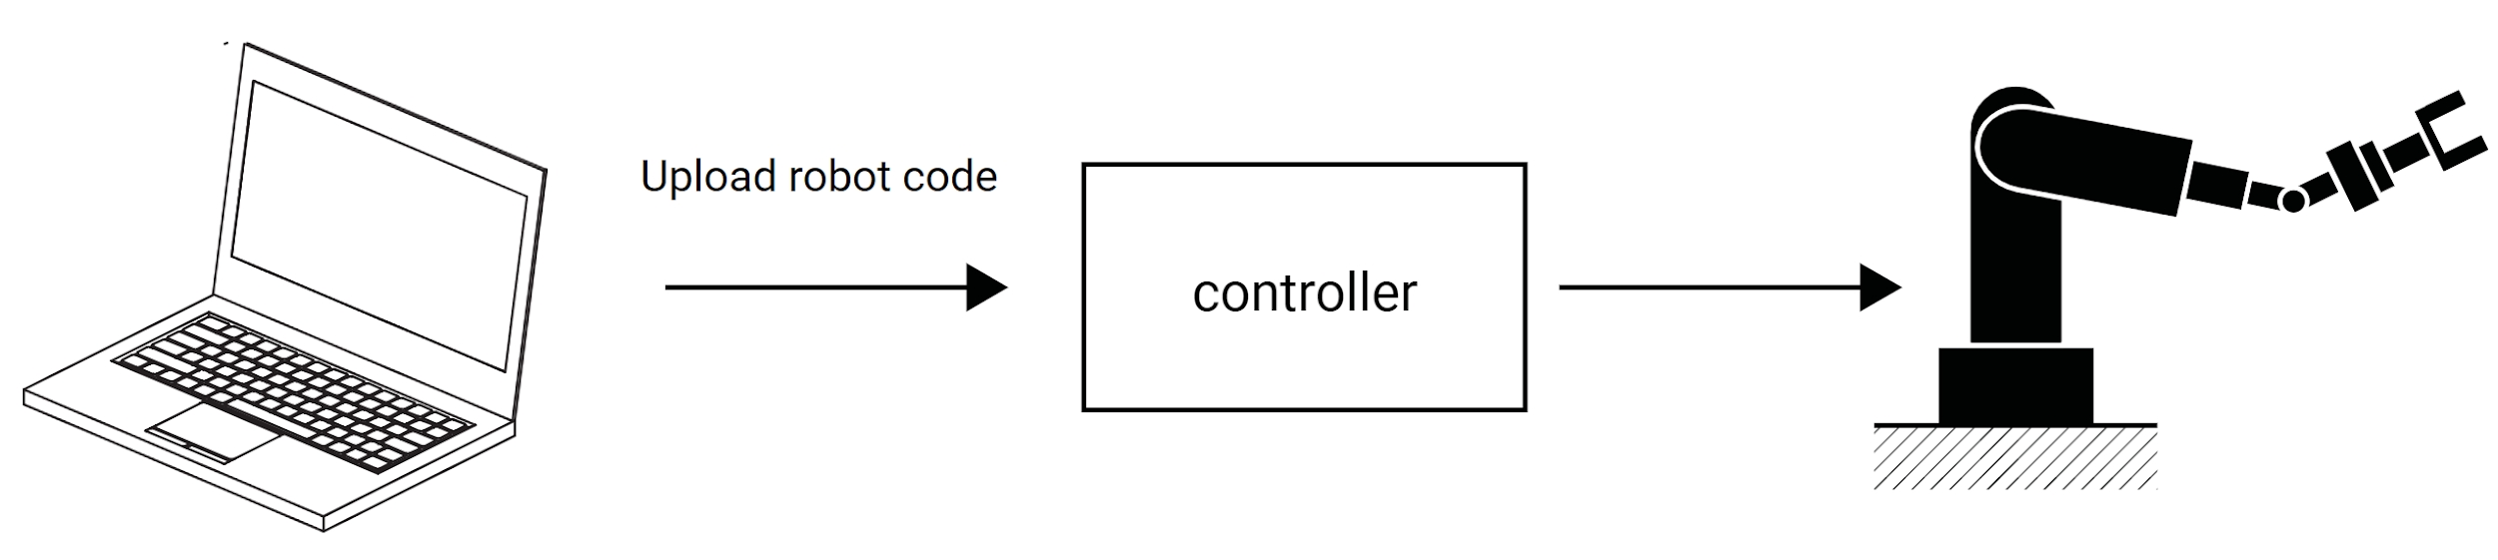
Robot Control
Offline control
Online control
real-time
non-real-time

Slide 20
Robot Control
Proprietary language and tools:
Offline control
Online control
real-time
non-real-time
Vendor | Language | Software
ABB Staubli UR KUKA | RAPID VAL3 URScript KRL | ABB RobotStudio Staubli Robotics Suite URSim KUKA WorkVisual

Slide 21
Robot Control
Offline control
Online control
real-time
non-real-time
Notes:
as an alternative ...

Slide 22
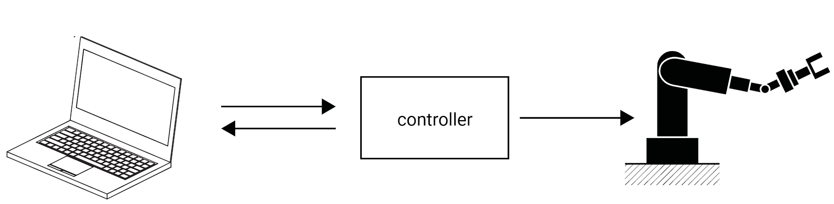
Robot Control
Offline control
Online control
real-time
non-real-time

Slide 23
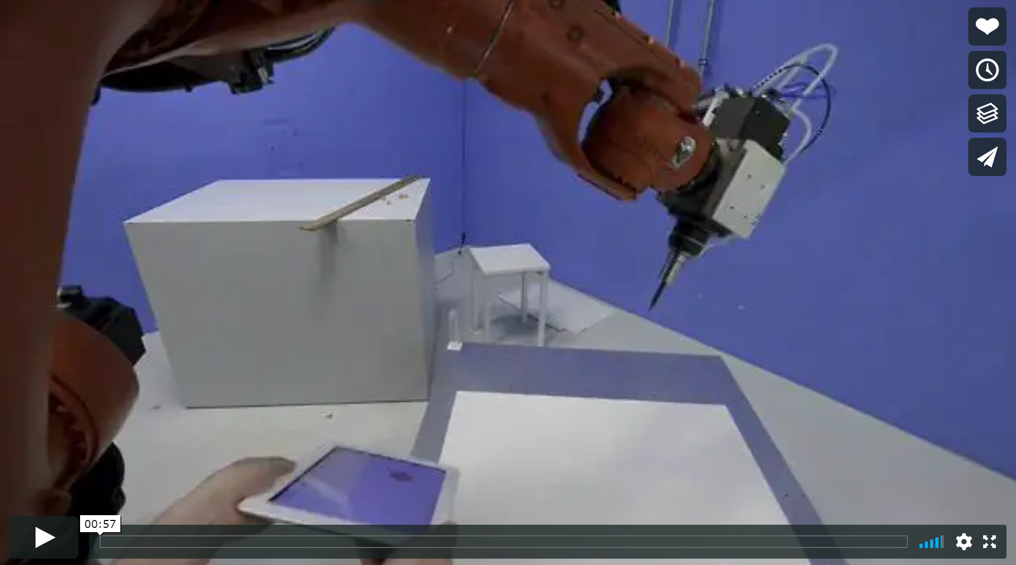
Example non-realtime online control

Slide 24
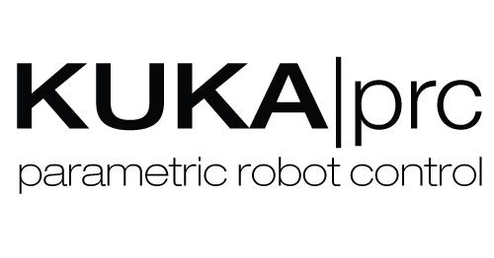




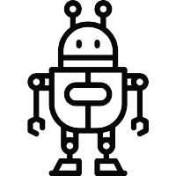
Robot control plugins from within CAD design environments
Notes:
G: State of tools. In contrast, COMPAS FAB -> is open source, online control, builds upon OSS state-of-the-art (output of robotic research goes into backends used by FAB), vendor-neutral.

Slide 25
UR Online Control
Notes:
UR online control is an intermediary step towards using Compas FAB

Slide 26
Installation

Slide 27
(base) conda config --add channels conda-forge
(base) conda remove --name afab19 --all
(base) conda create -n urfab python=3.6 compas=0.11 compas_fab=0.9 --yes
(base) conda activate urfab
(afab19) python -m compas_rhino.install
(afab19) python -m compas_fab.rhino.install -v 6.0
Notes:
Open Anaconda prompt

Slide 28
(afab19) conda install jupyter rise pythreejs jupyter_contrib_nbextensions jupyter_nbextensions_configurator --yes

Slide 29
(afab19) python
>>> import compas_fab
>>> compas_fab.__version__
'0.9.0'
>>> exit()

Slide 30
Installation
Download the .msi file and install Ironpython 2.7.9. via: https://github.com/IronLanguages/ironpython2/releases/tag/ipy-2.7.9
Clone
https://github.com/augmentedfabricationlab/ur_online_control
into you workspace/projects folder.
Open Rhino and add the following 2 directories to the Python path via
> EditPythonScript > Tools > Options > Add to search path:
Ironpython Path, e.g., C:\Program Files\IronPython 2.7\Lib
Parent folder or ur_online_control repository, e.g., C:\Users\yname\workspace\projects

Slide 31
UR Online Control
You find the grasshopper playground in the repo’s ghcomp folder:
ur_online_control.ghx
ur10e_setup.3dm
Copy these two files into your own project folder, and use and customize it to your needs.
Notes:
UR online control is an intermediary step towards using Compas FAB

Slide 32
(base) conda create -n uronl python=2.7.16
(base) conda activate uronl
Notes:
For running the main file, you need to set up a Pyhton 2.7 environment

